Slide 1
Macro Outlook Replication with Data

Slide 2
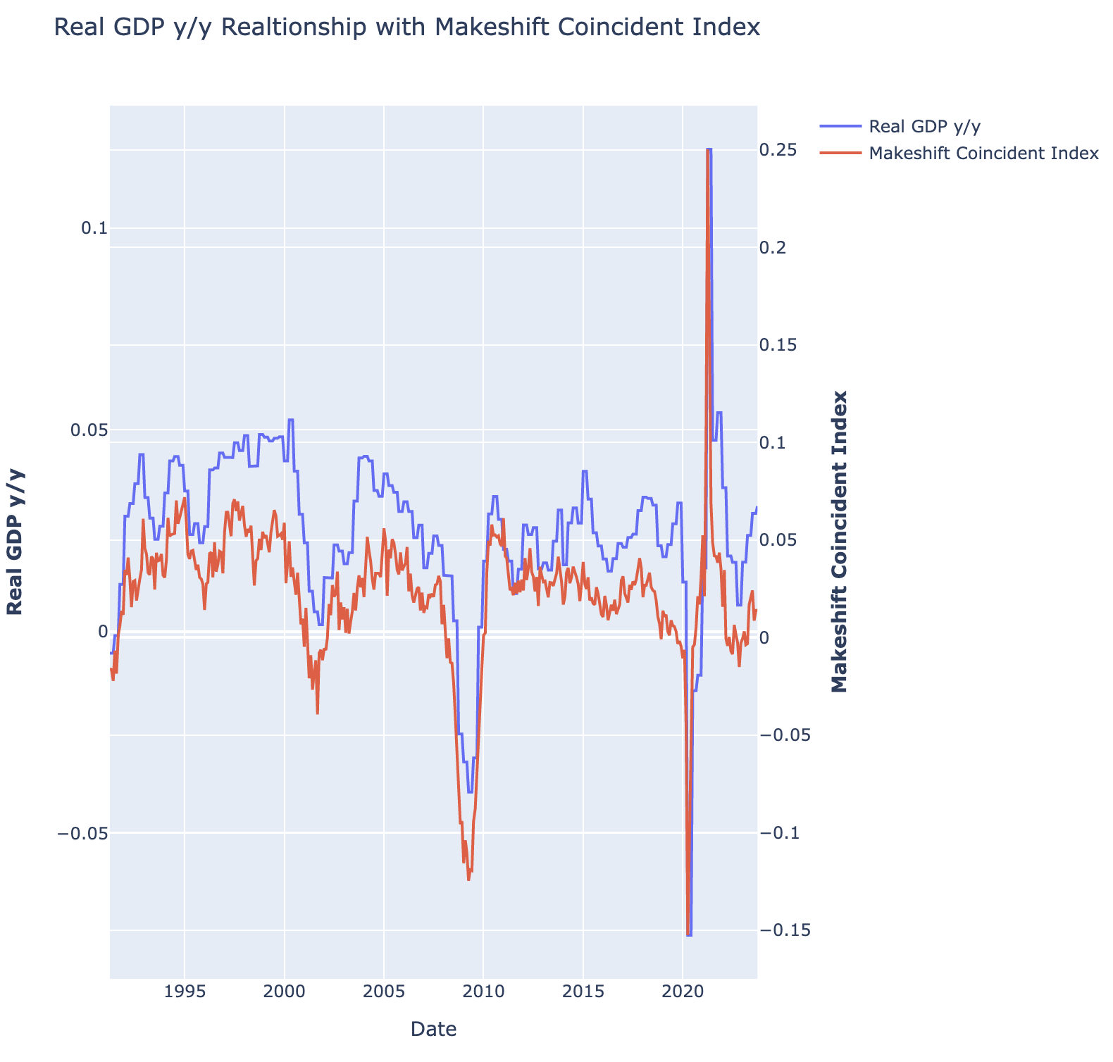
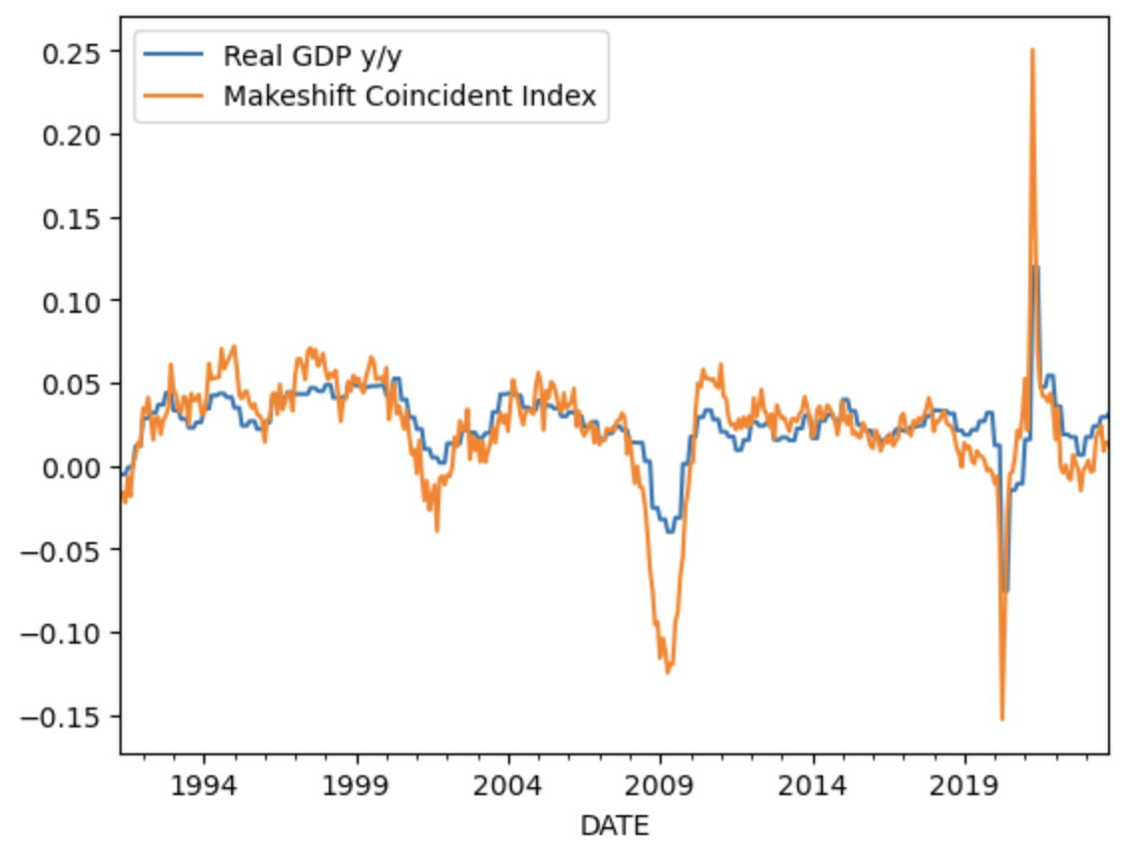
Coincident Index to GDP – Replacing LEI
Leading Economic Indicator has declined 21 months in a row.
The Fed’s most intense hike since the ‘70s
Manufacturers reduced inventories
Faced pressures from high input prices
China’s closure in 2022
Coincident Index - reflects employment, household income, industrial output, and business revenue.
Less cyclical and coincides with economic activity
Couldn’t find the LEI on FRED, but used a monthly average of the following:
Real Manufacturing and Trade Industries Sales
Real Personal Income excluding Current Transfer Receipts
Industrial Production
Nonfarm Payrolls

Slide 3
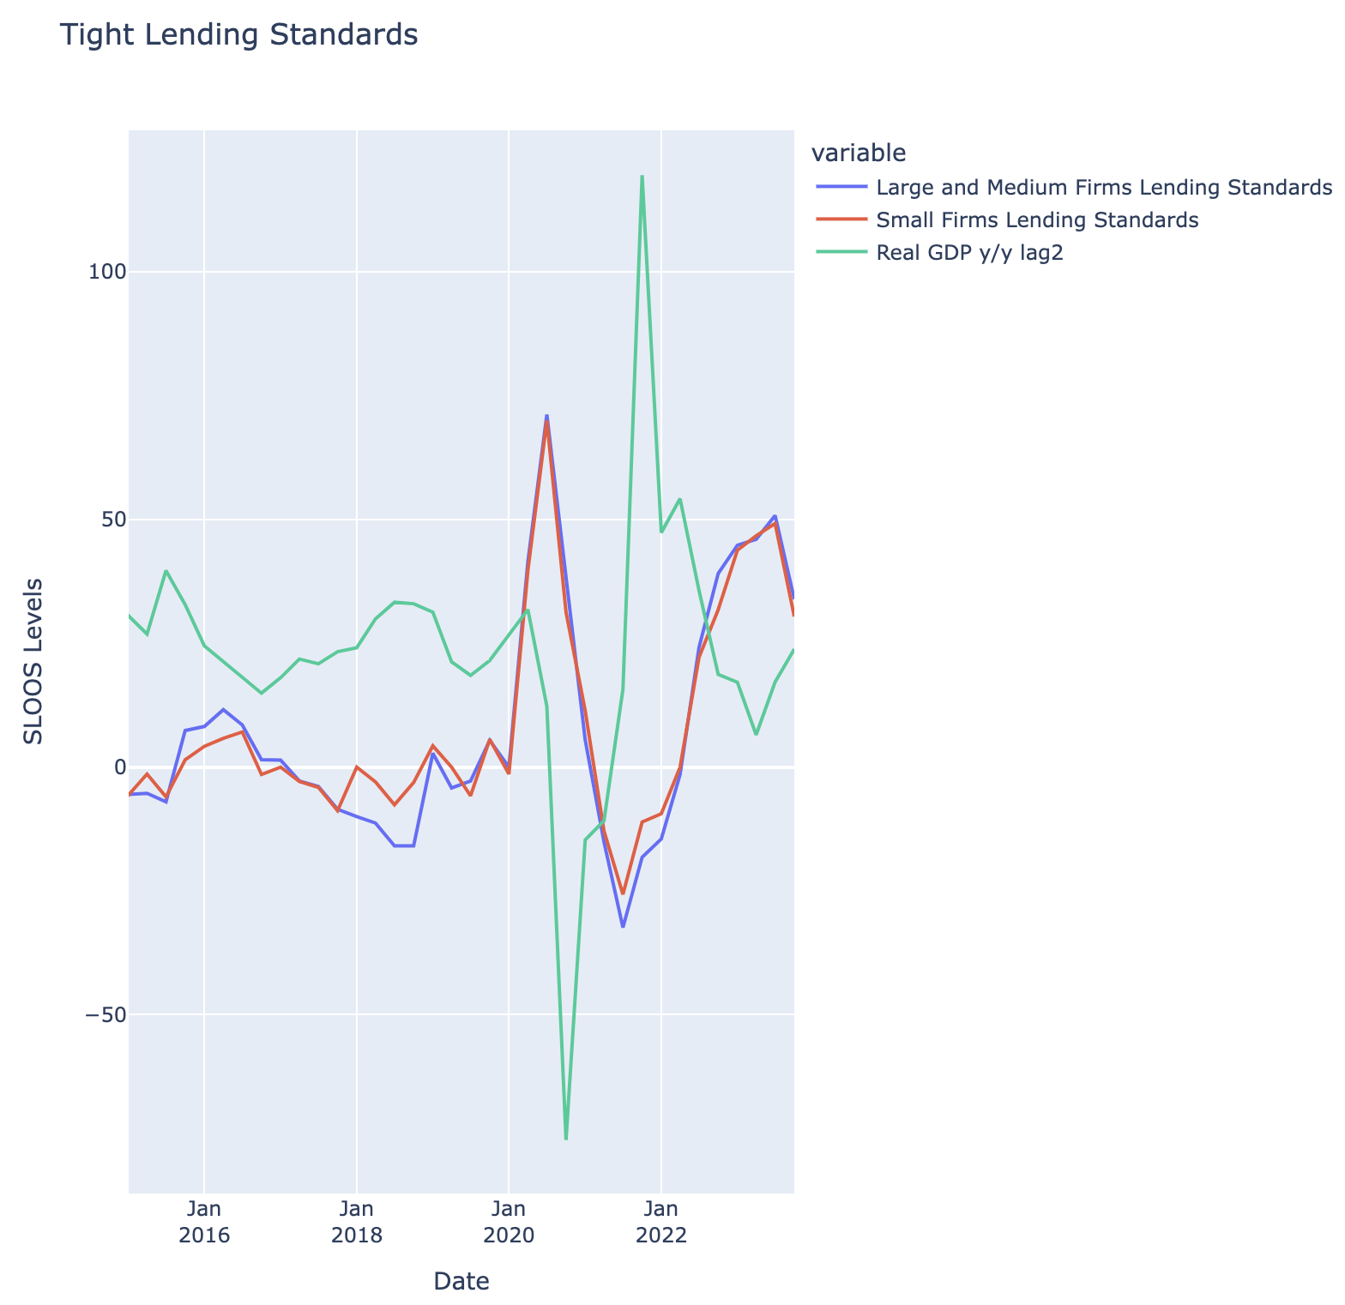
Tight Lending Standards
Tighter lending standards have been correlated to slower growth periods as Banks lend less.
Multiplied Real GDP y/y by 1000 to scale
Lag 2 Example: April GDP was pulled ahead to October

Slide 4
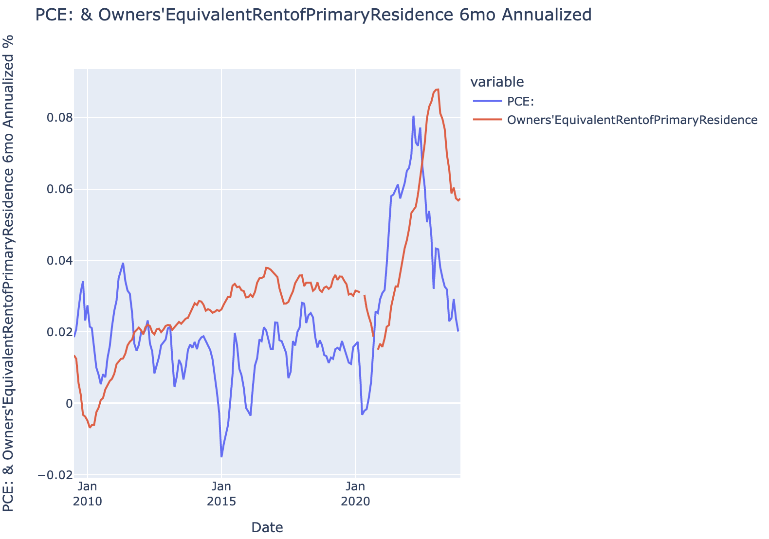
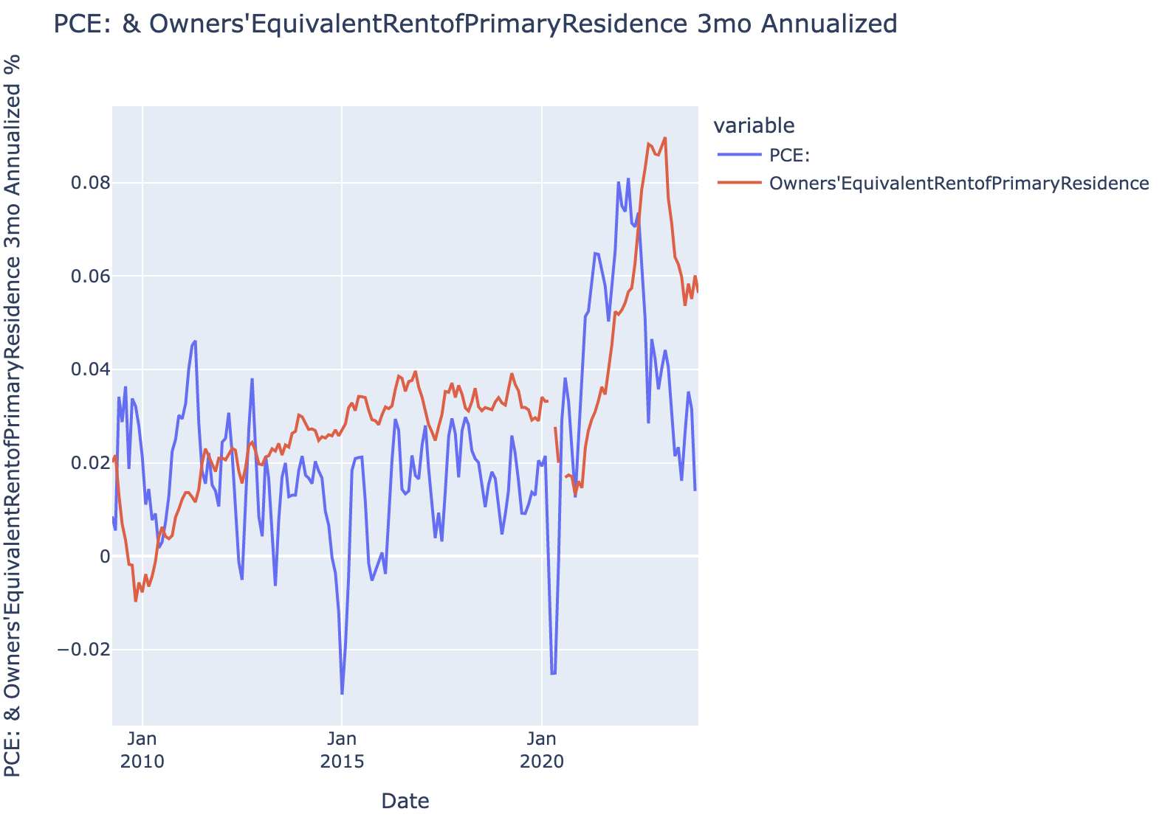
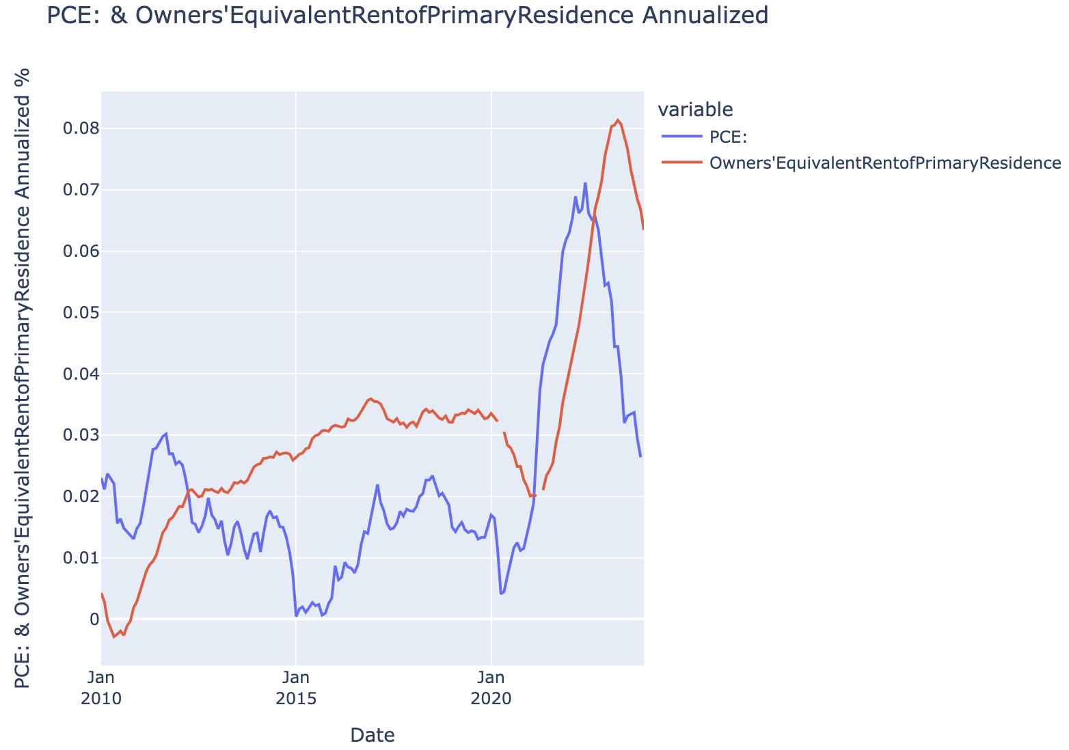
PCE Inflation Normalizing to Fed Target
CPI inflation is getting propped up by the rent and shelter portion which usually operates in a lag. This should normalize as Apartments List and Zillow show lower shelter and rent prices.
Compared annualized, 6-month annualized, and 3-month annualized PCE to CPI OER

Slide 5
Core CPI and Unemployment: Fed Rate Cuts
Can see why the markets are pricing in rate cuts starting at the beginning of March
Recent Fed speak (Bostic) doesn’t want to cut and then need to hike again
These are all the times where Fed started to cut rates
Green Text: Where we were most recently
Just under 4.0% for CORE CPI
Low Unemployment (3.7%)

Slide 6
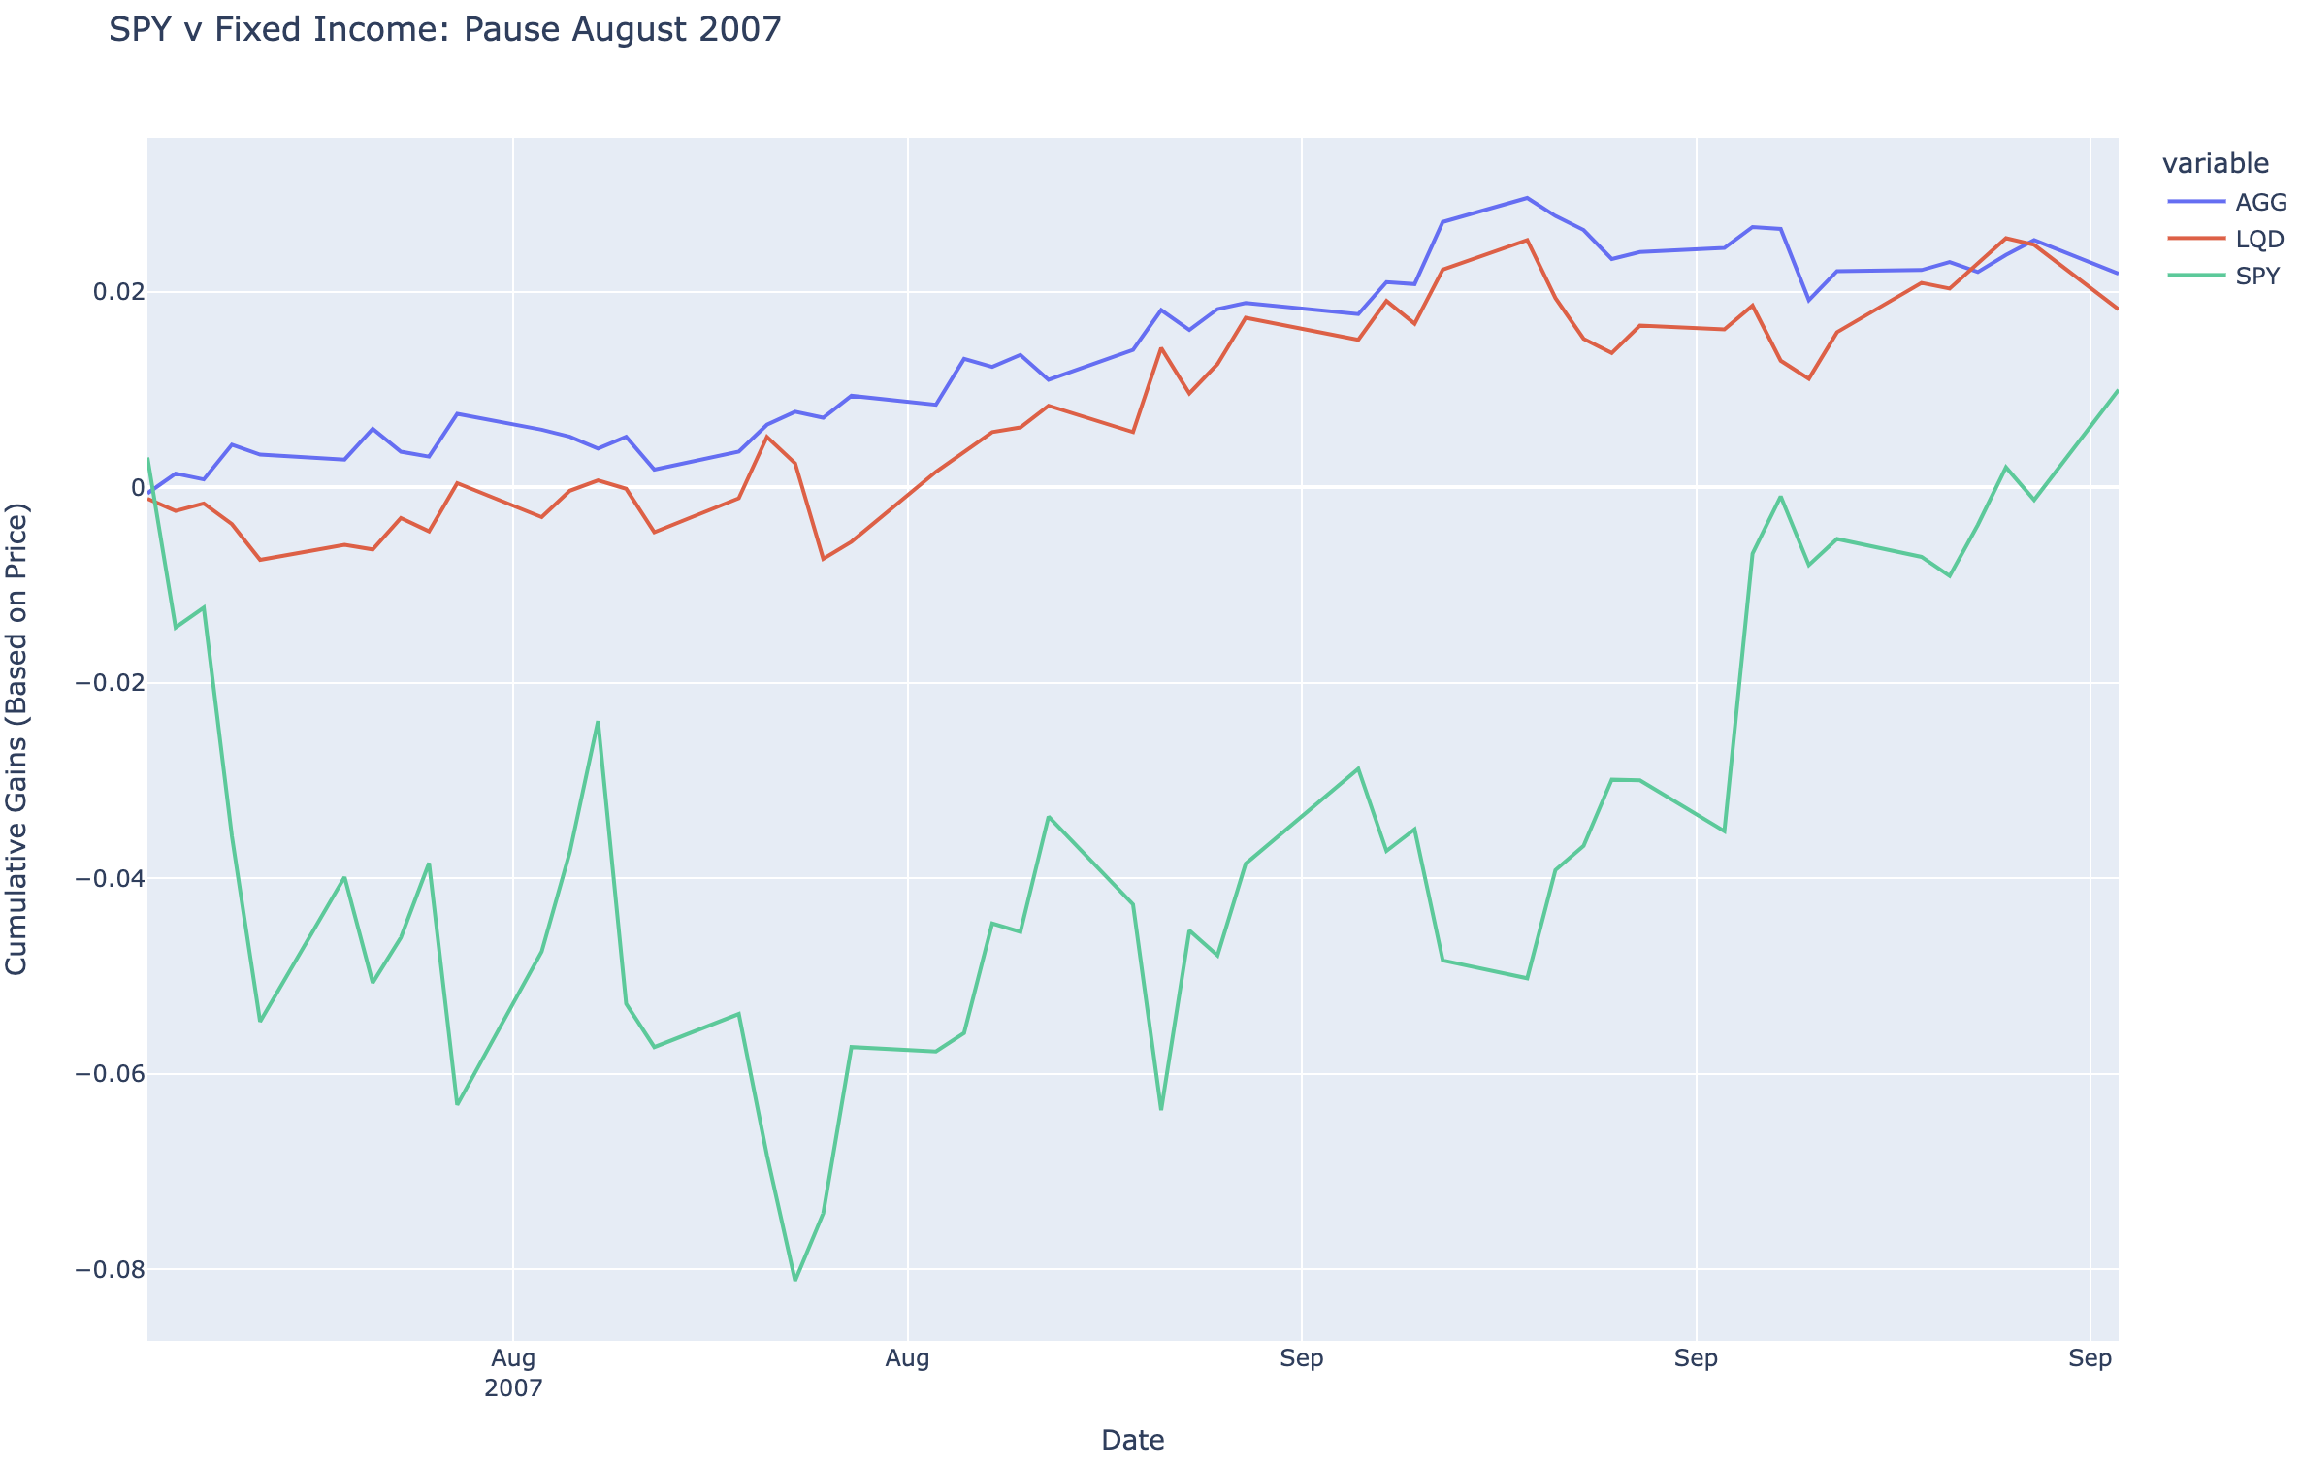
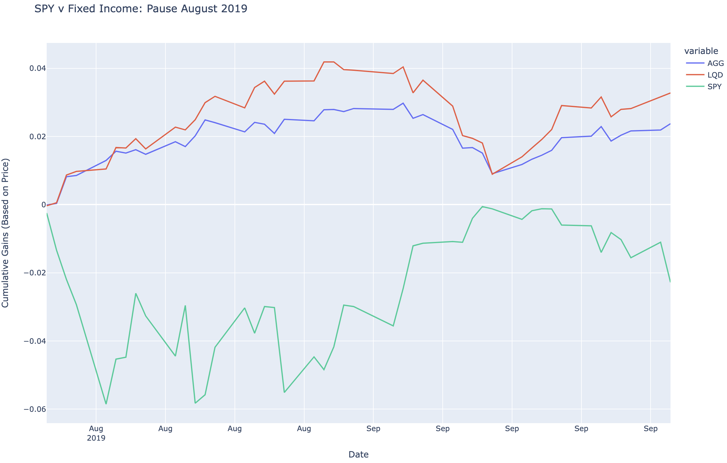
Fixed Income outperforms after Fed Pause

Slide 7
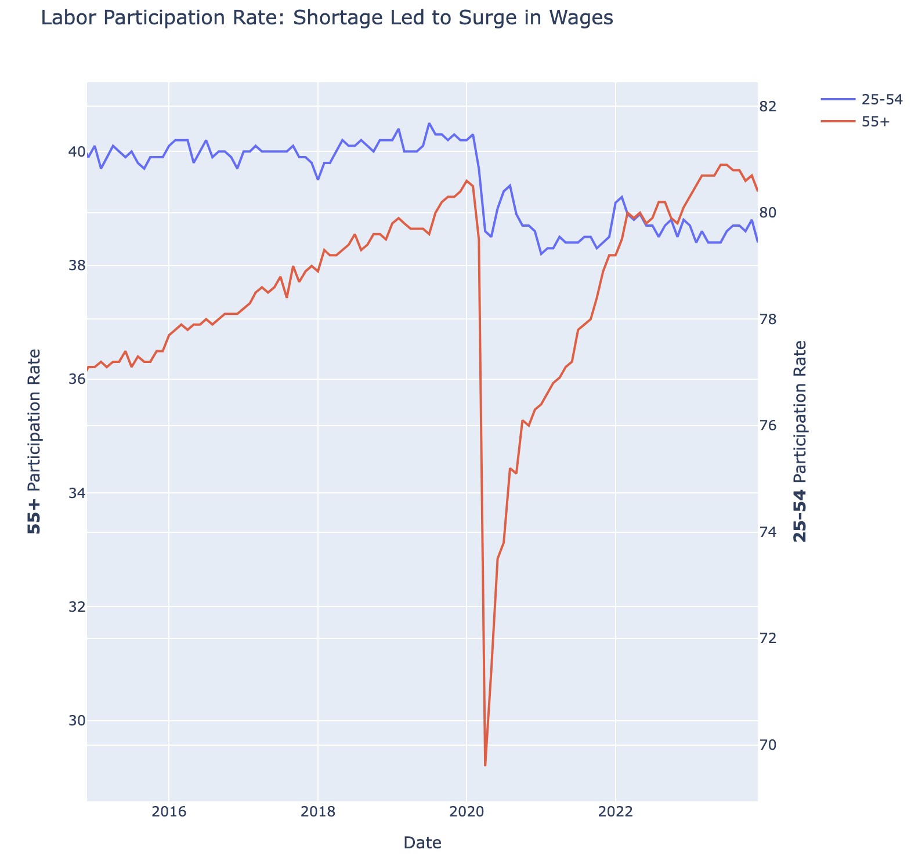
Labor Force Participation Rate – Leading to Surge in Wages
The pandemic led early retirements that left the labor force around 2 million workers short from pre-pandemic estimations.
The sudden shortfall in labor led to rapid wage increases that attracted more people into the work force to ease the shortage that has since leveled off

Slide 8
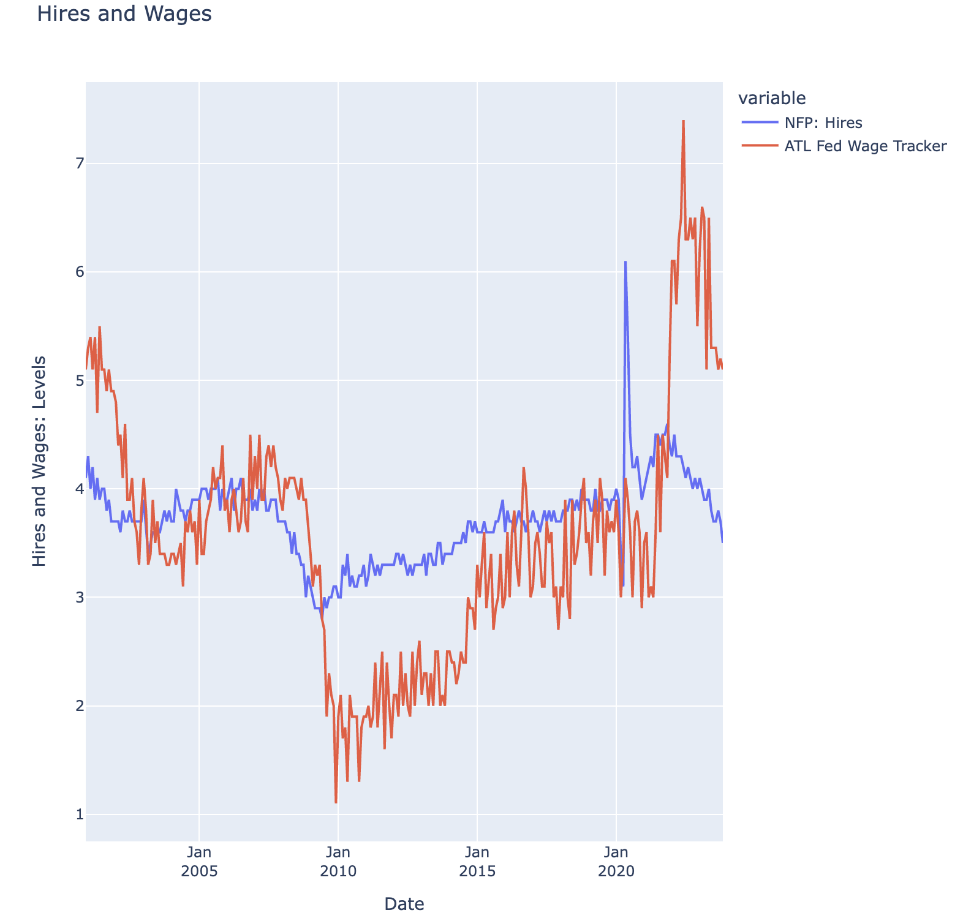
NFP Hires and Wages starting to Normalize
Wages are normalizing as new hires are declining from highs.

Slide 9
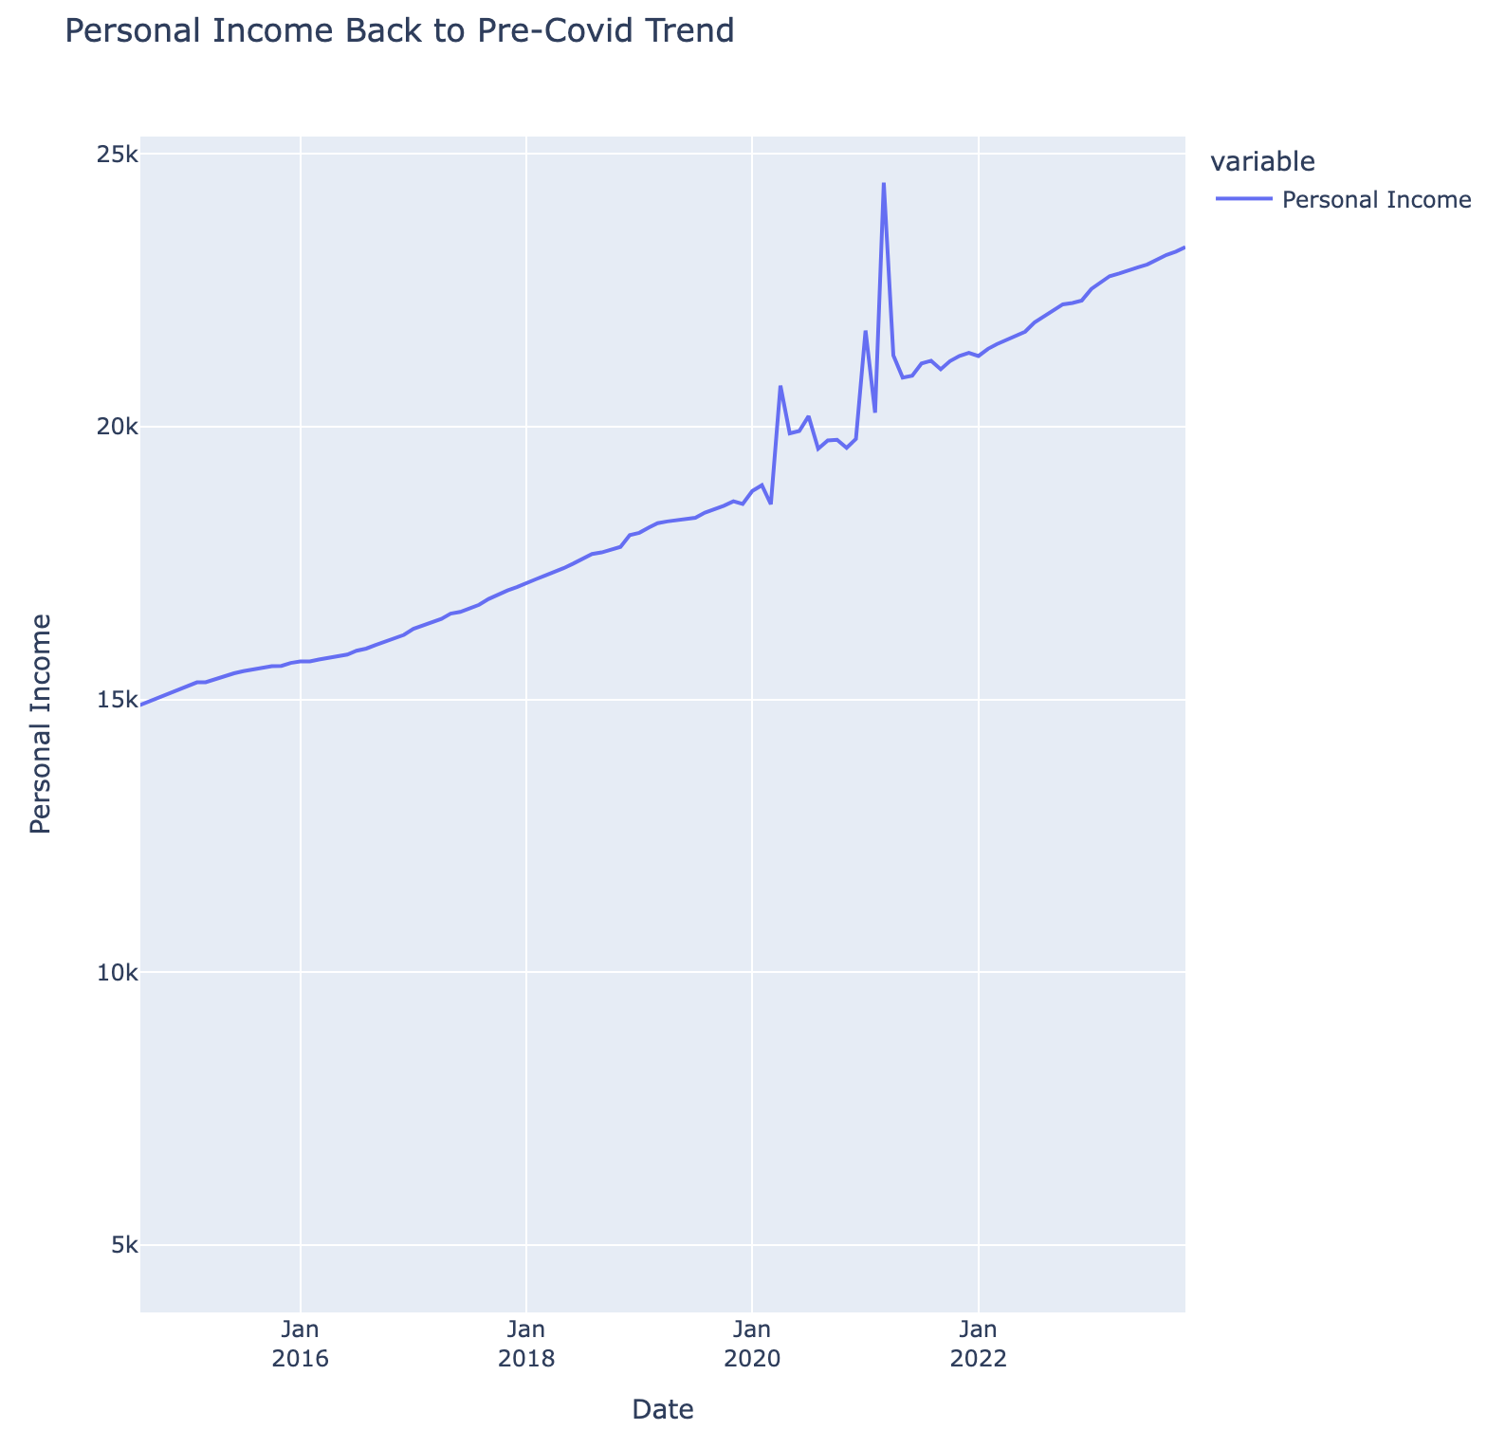
Personal Income
Personal Income has fallen back to pre-Covid trend.
Disposable Incomes recovered leading to better consumer demand in ’23.

Slide 10
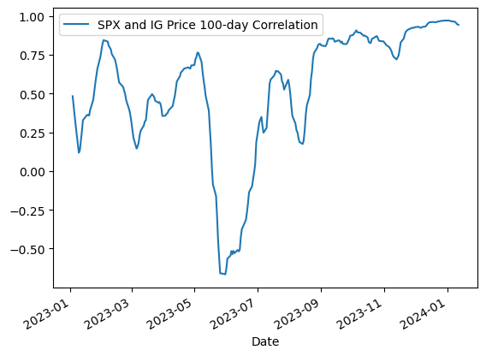
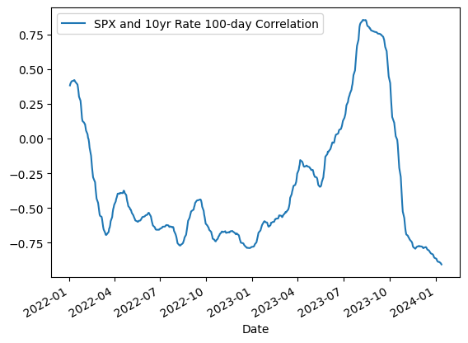
IG (Price) & Treasuries (Yield) Moving with Equities – Alternative Assets like Hedge Funds & Private Equity

Slide 11
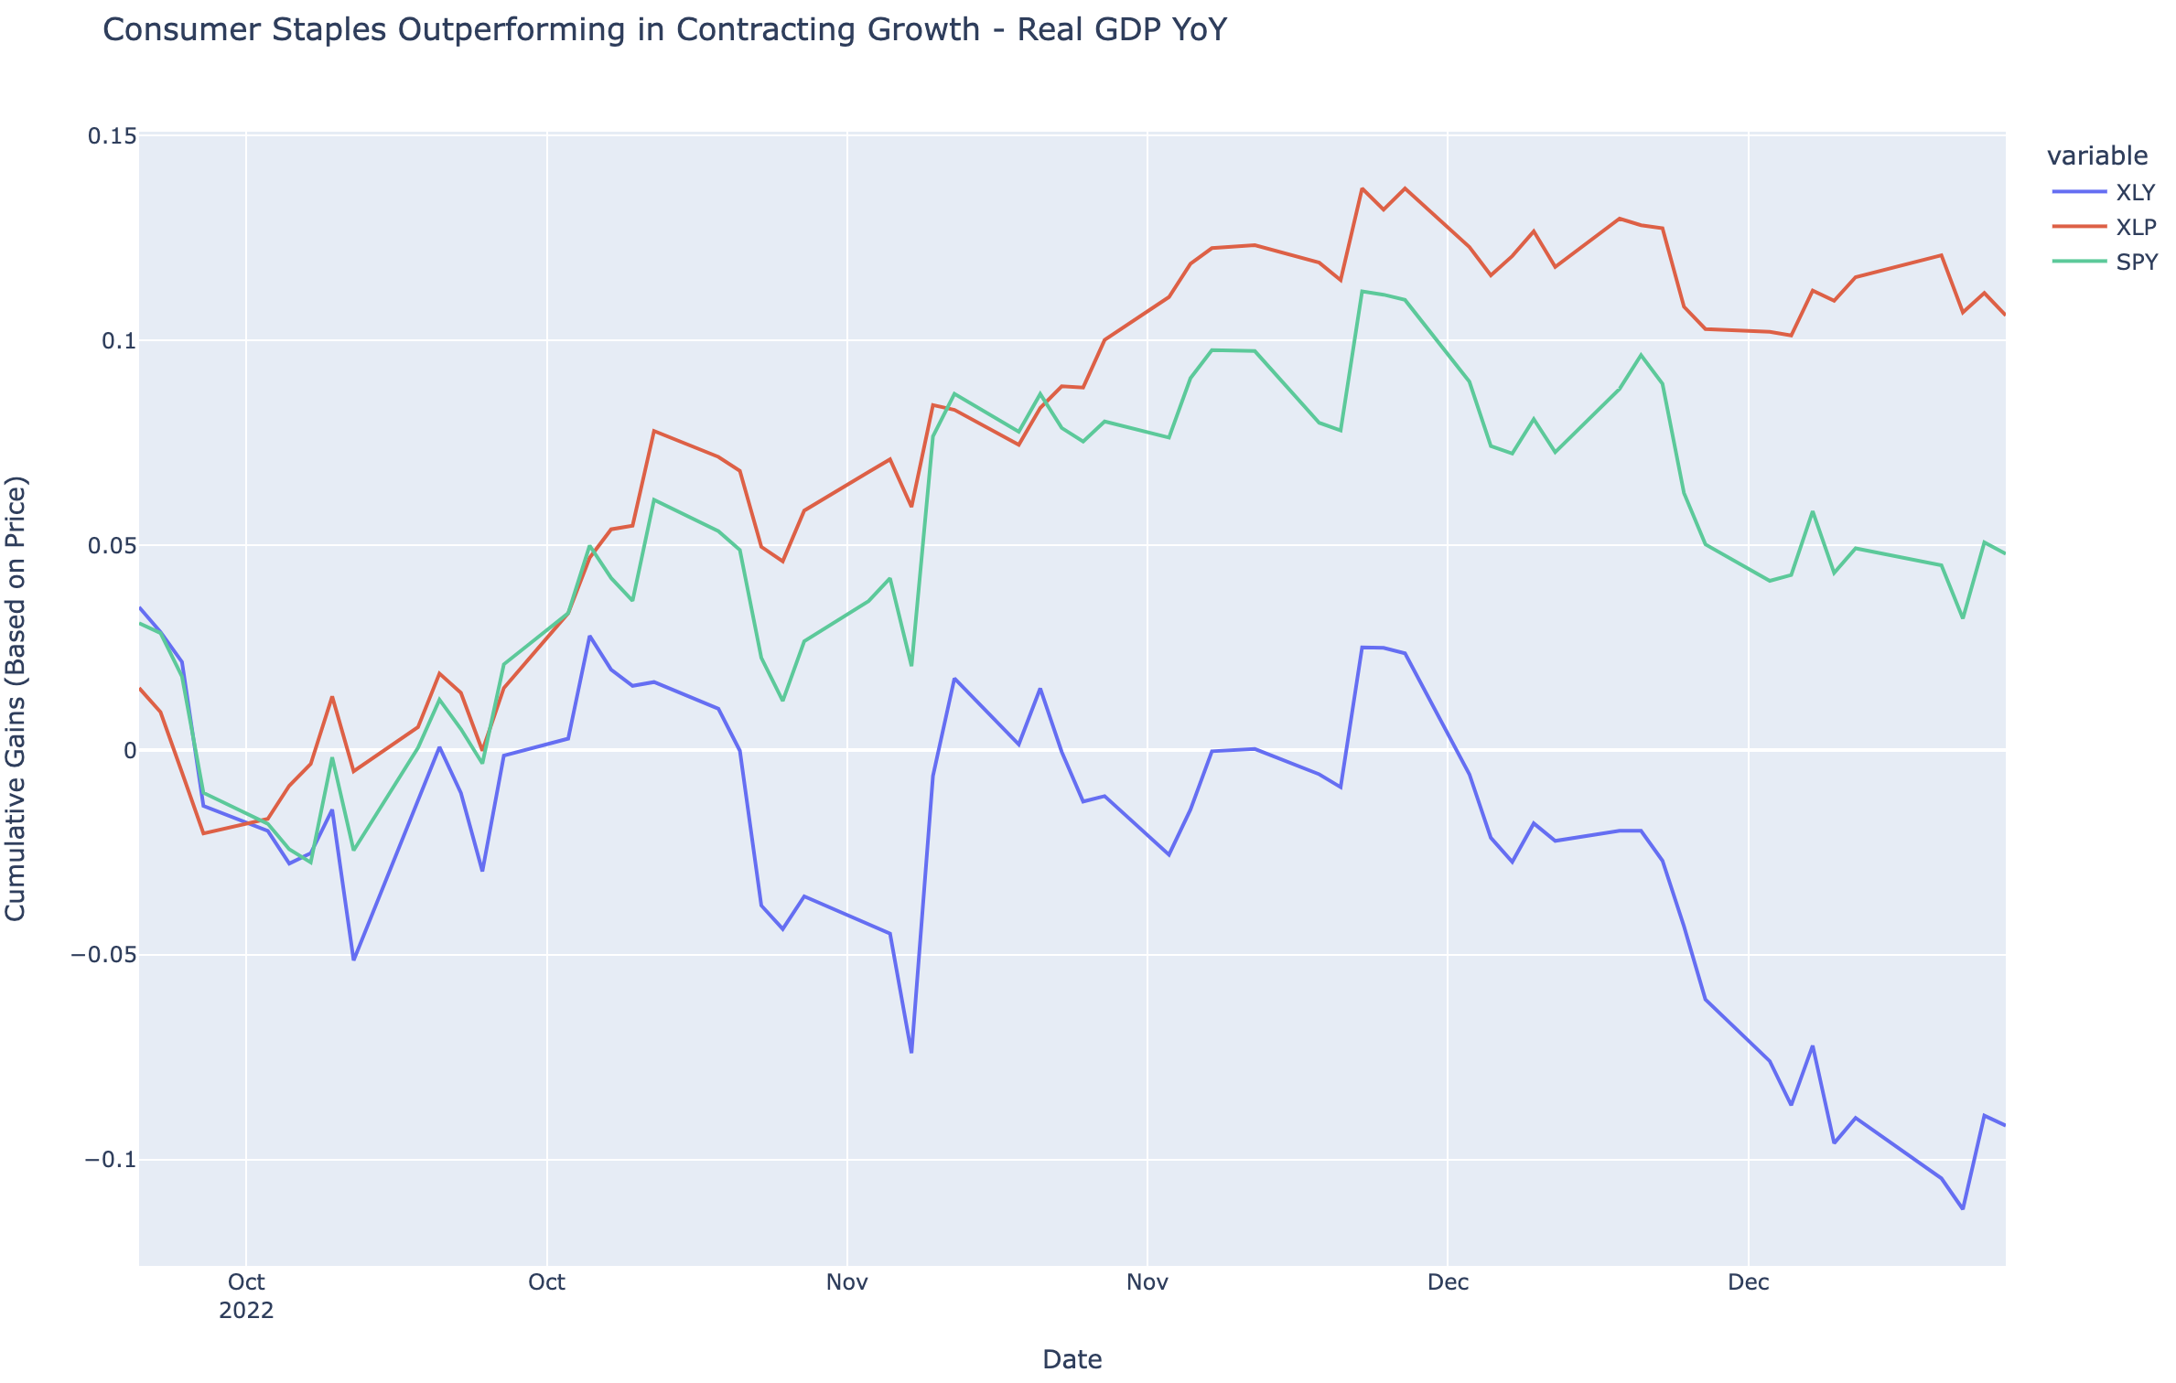
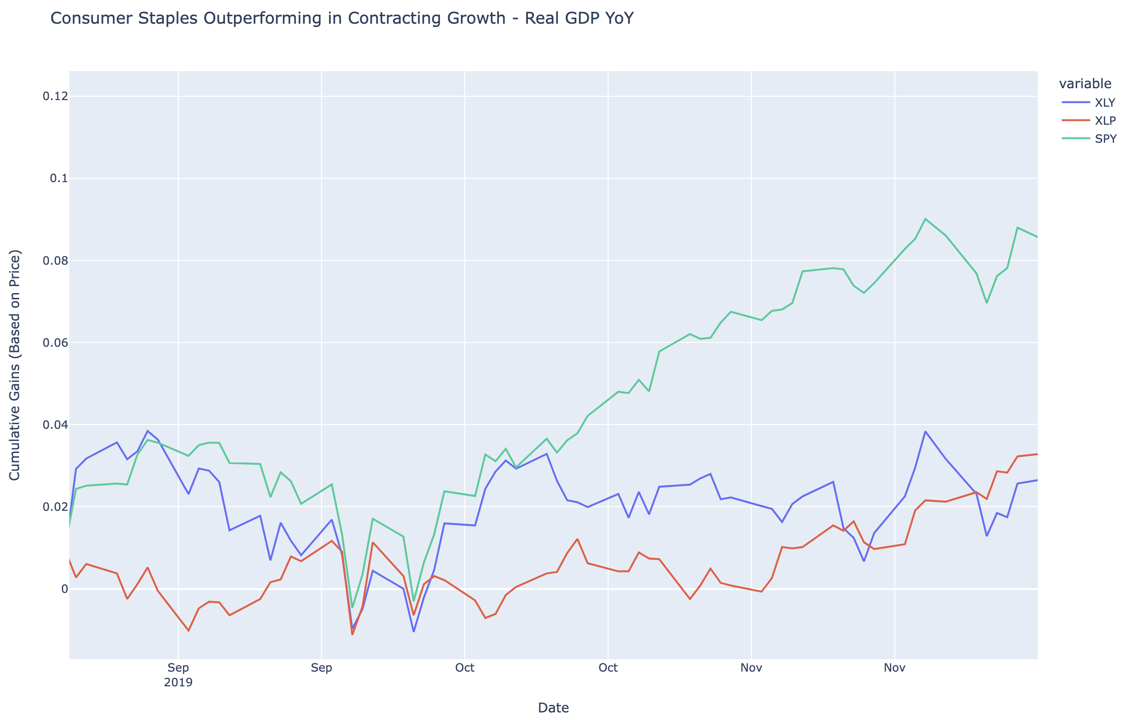
Consumer Staples to Consumer Discretionary – Declining Growth
Consumer Staples tends to outperform when growth is set to slow
Soft data has pointed to increasing stress on the consumer (bank earnings)
Net Charge Offs are up on GSIBs almost double from 23Q1 to 23Q4

Slide 12
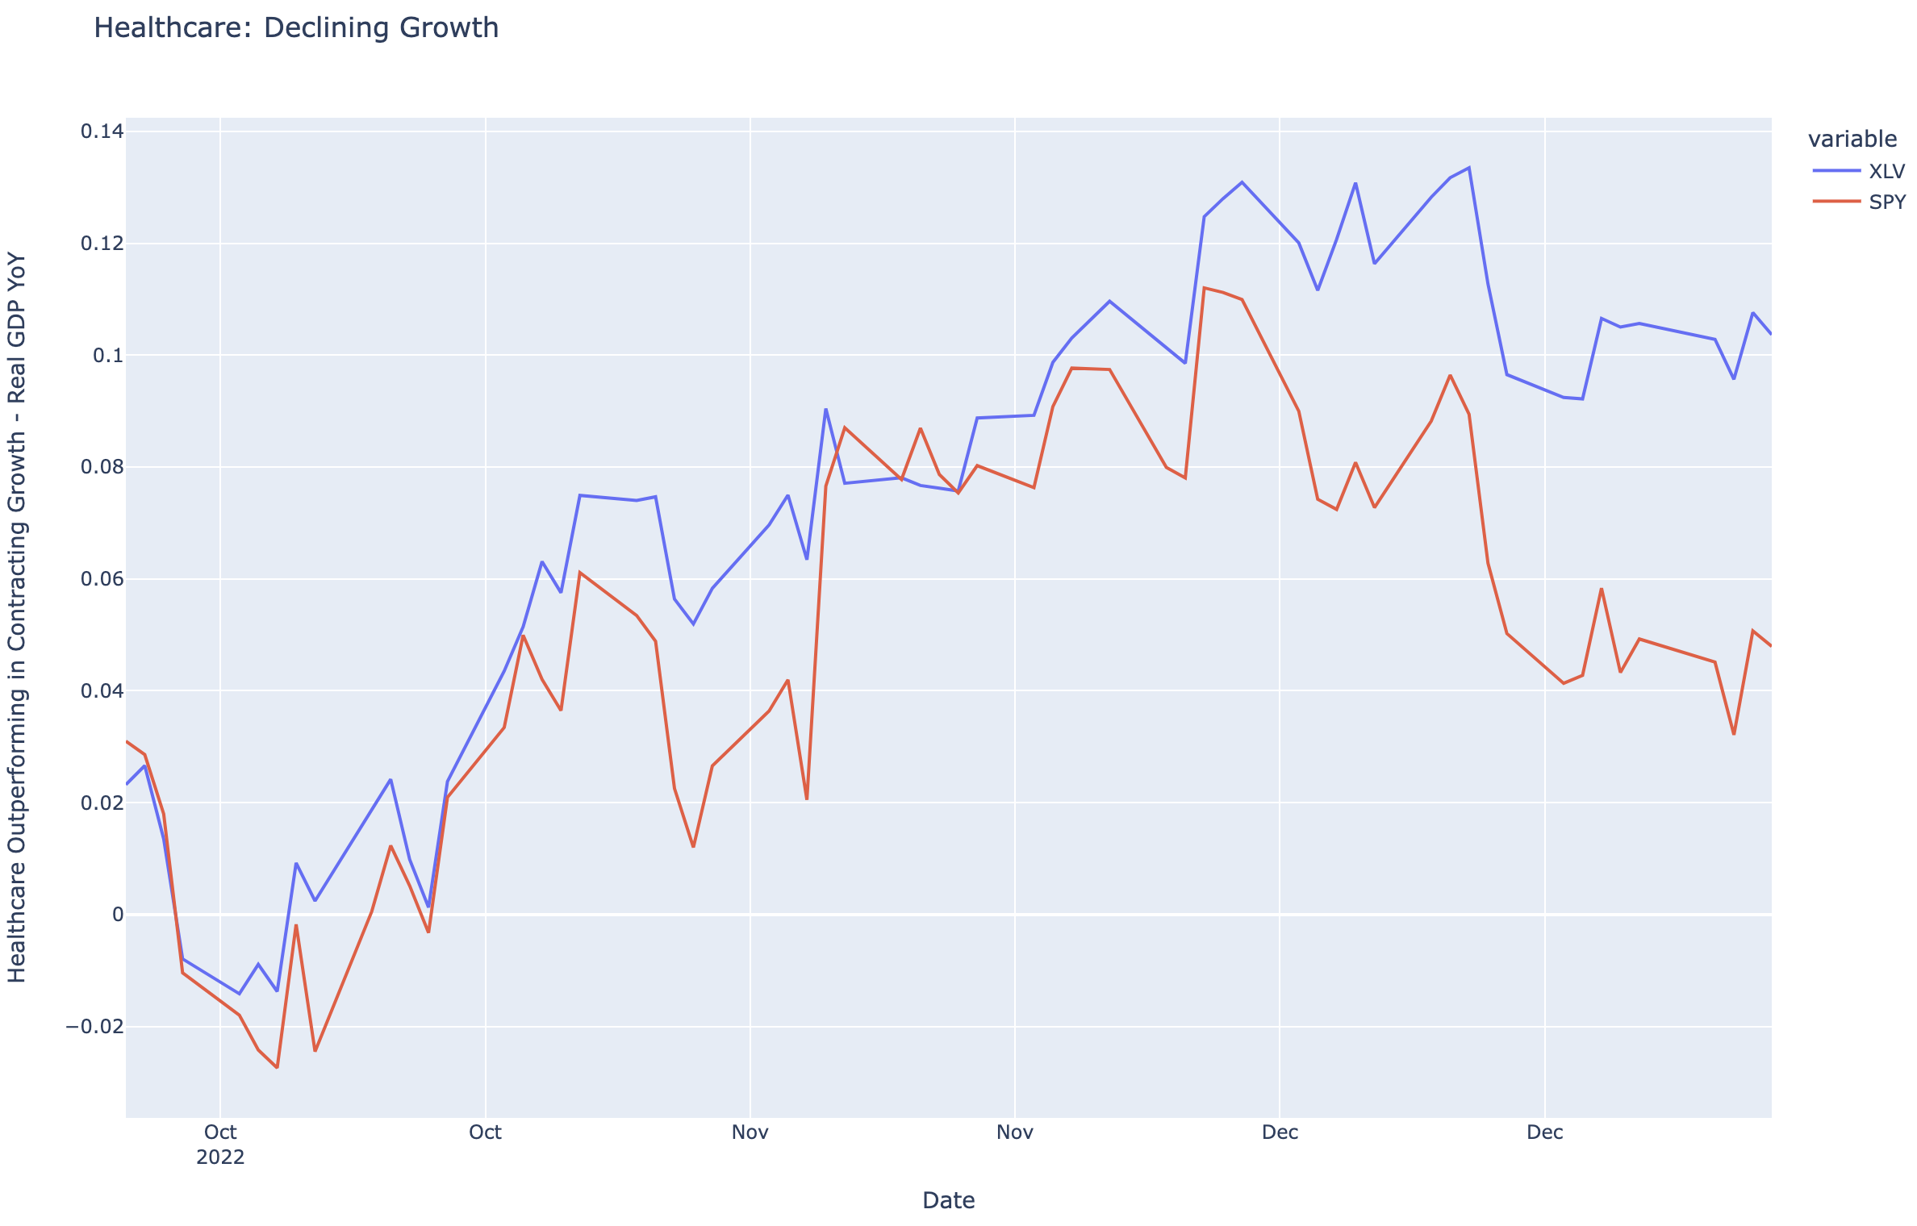
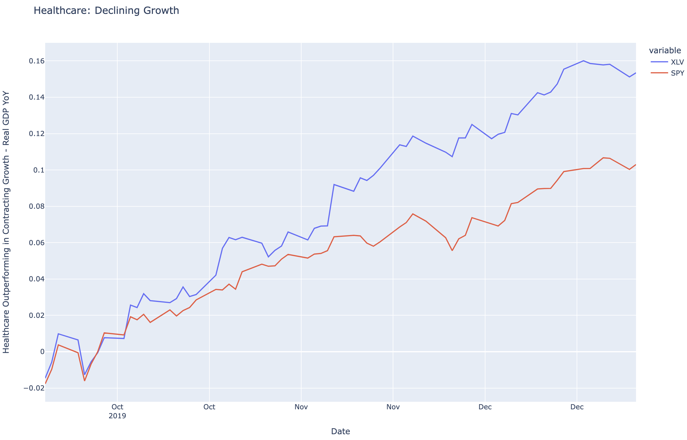
Healthcare to S&P 500 – Declining Growth
Healthcare equities tend to outperform when Real GDP slows year-over-year.
Consumer Demand is expected to slow as wages normalize and personal savings continue to dwindle down.

Slide 13
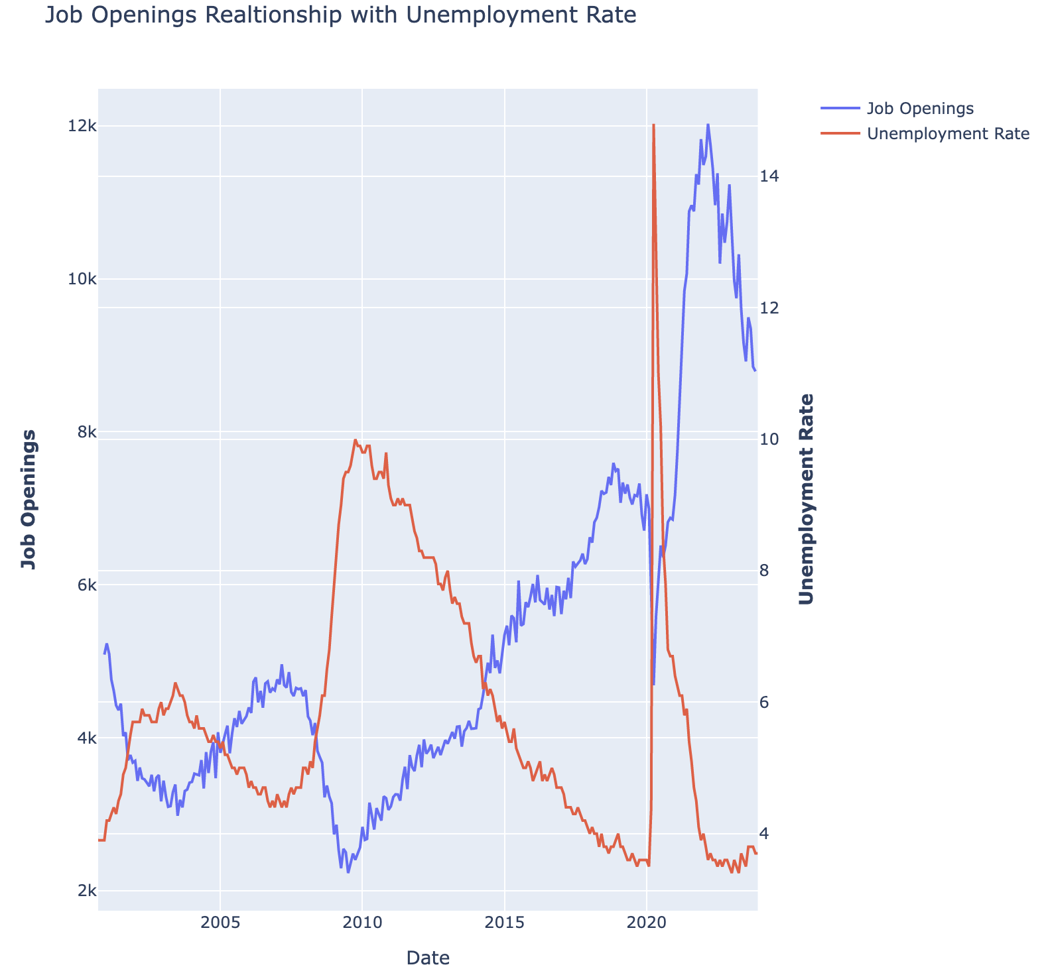
Job Openings to Unemployment Rate
Job openings tend be inversely related to the unemployment rate
As there are less job openings, unemployment goes up.

Slide 14
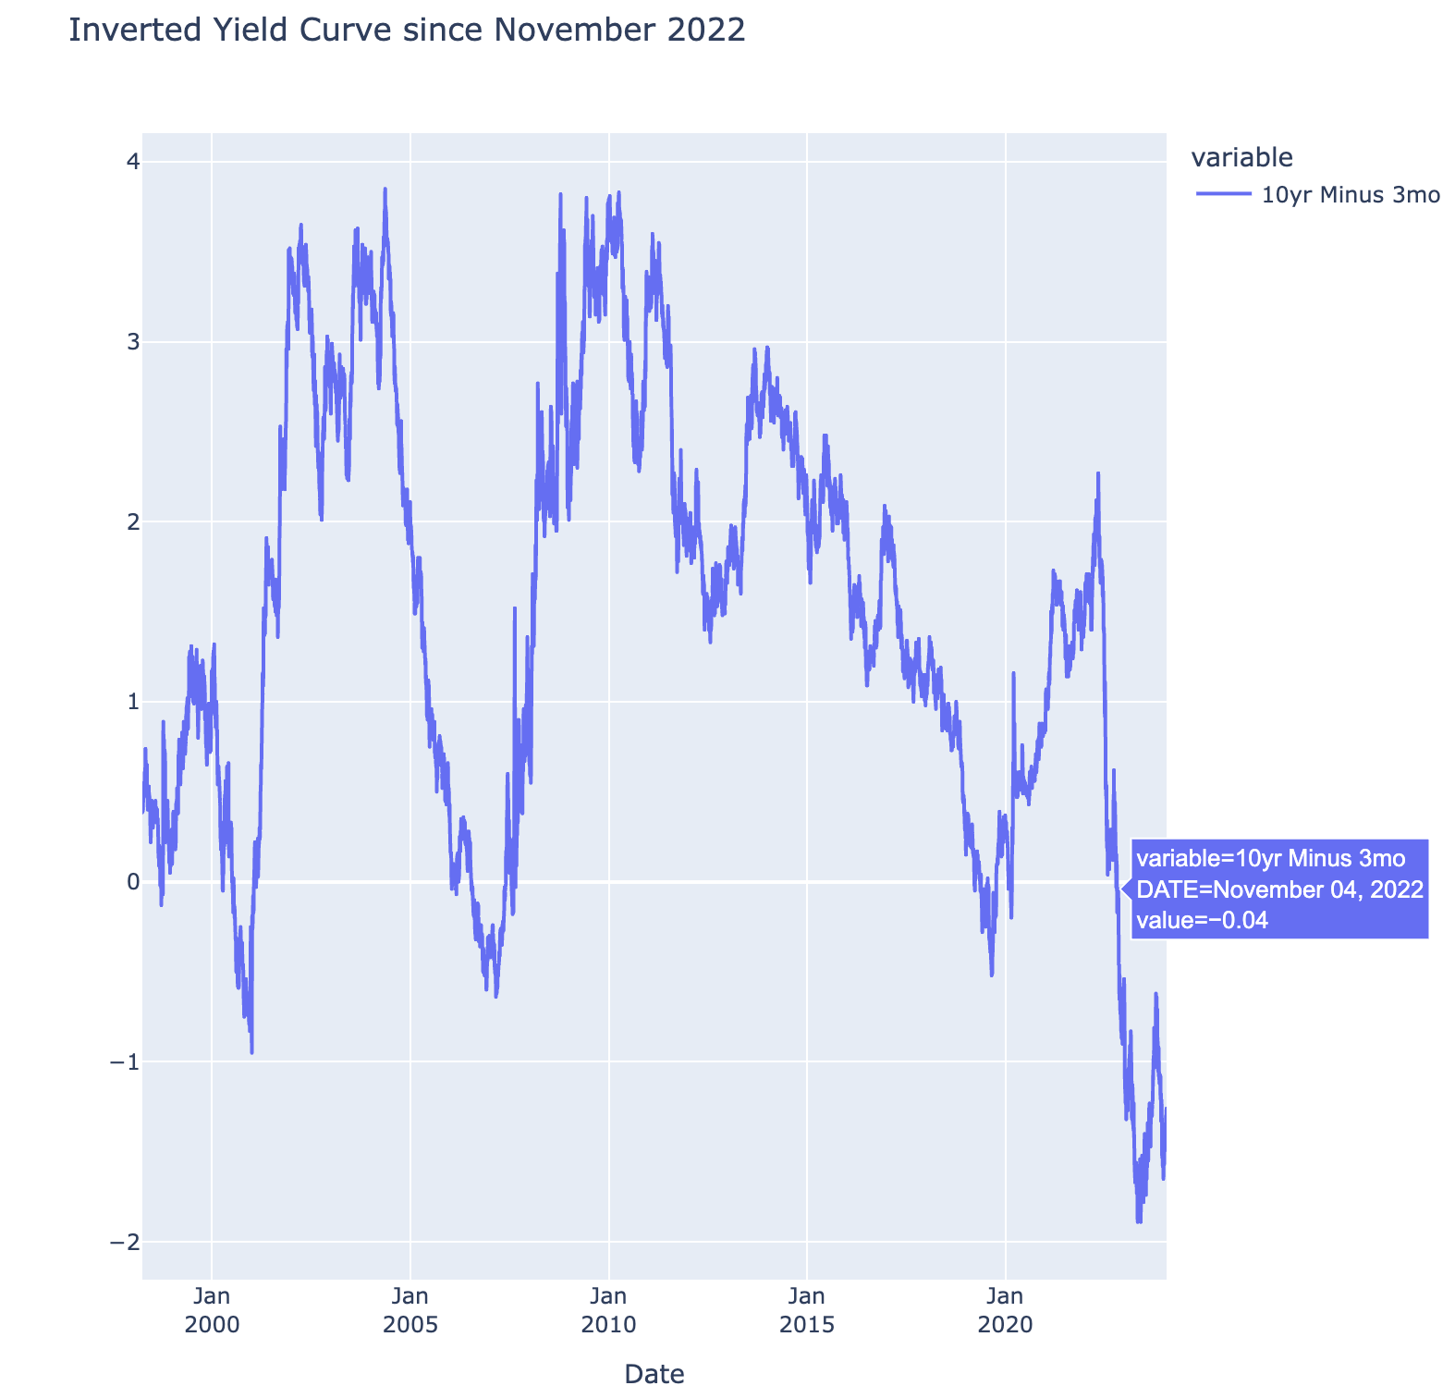
Inverted since November of 2022
When market becomes more fearful of the economy, flight to quality takes place as investors rush into the 10-year treasury that is risk free and very liquid.
The yield on the ten-year drops as more demand from the flight to quality drives up the price.

